Slide 1
chapter one
Feedback amplifier
Prepared by biruk s.(Msc)

Slide 2
Out line
Introduction
Feedback concept
Feedback topologies
Classification of amplifiers
Effect of feedback on different parameters
Analysis of feedback amplifiers
1

Slide 3
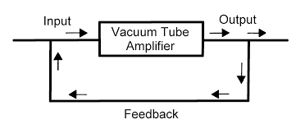
INTRODUCTION
An amplifier circuit is simply used for increasing the strength of the signal.
Although while amplifying, the input signal strength can be increased whether it includes information otherwise information with some noise.
What is a Feedback Amplifier?
The feedback-amplifier can be defined as an amplifier which has feedback lane that exists between o/p to i/p.
How amplified noise is minimized in amplifier circuit?
2

Slide 4
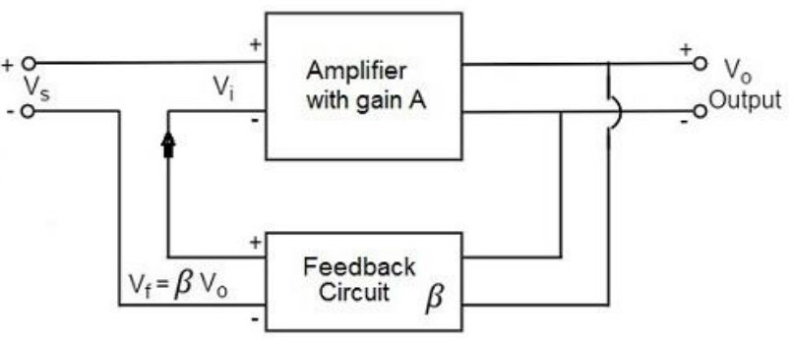
Feedback concept
Principle of Feedback Amplifier
A feedback amplifier generally consists of two parts.
They are
The amplifier and
The feedback circuit.
The feedback circuit usually consists of resistors.
A is gain
β is feedback factor Vf/Vo
The output Vo must be equal to the input voltage (Vs - βVo) multiplied by the gain A of the amplifier.
3

Slide 5
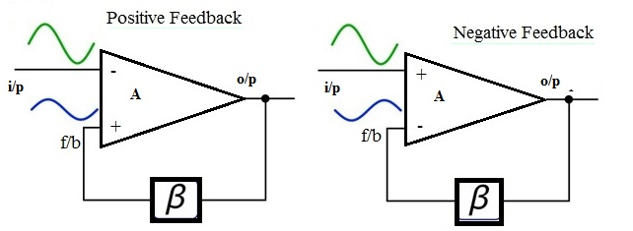
Cont….
What is feedback?
The procedure of introducing some device’s output energy fraction back to the i/p is termed as Feedback.
Types of Feedback Amplifier
Depending upon whether the feedback signal aids or opposes the input signal, there are two types of feedbacks used.
4

Slide 6
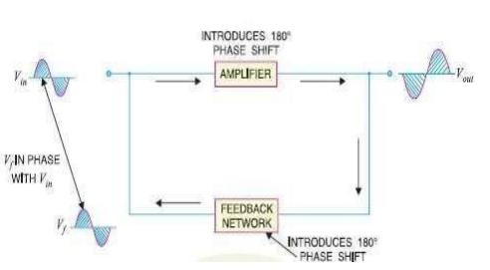
Cont…
1.) Positive Feedback Amplifier
If the feedback signal is in the phase with the input signal, the effective input to the circuit is increased and this type of feedback is called positive, regenerative or direct feedback.
But, it amplifies the original signal power and can be used in oscillator circuits.
Disadvantage of positive fb
Increasing distortion
Instability
3
5

Slide 7
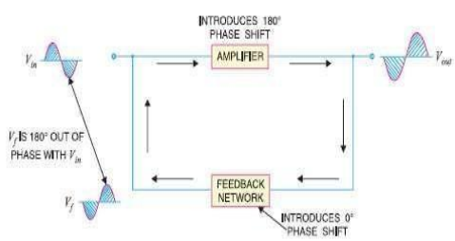
cont….
2.) Negative Feedback Amplifier
The feedback in which the feedback energy i.e., either voltage or current is out of phase with the input and thus opposes it, is called as negative feedback.
The o/p signal is or odd integer multiples of 180 with respect to the input signal
Advantages of negative fb such as
Stability of gain is improved
Reduction in distortion
Reduction in noise
Increase in input impedance
Decrease in output impedance
How about disadvantage of –ve feedback?
3
6

Slide 8
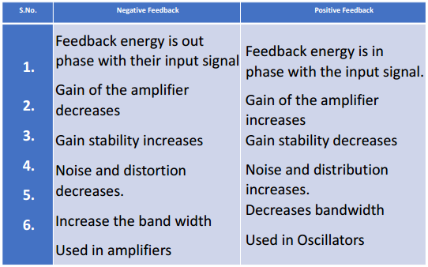
cont….
Comparison Between Positive and Negative Feed Back:
3
7

Slide 9
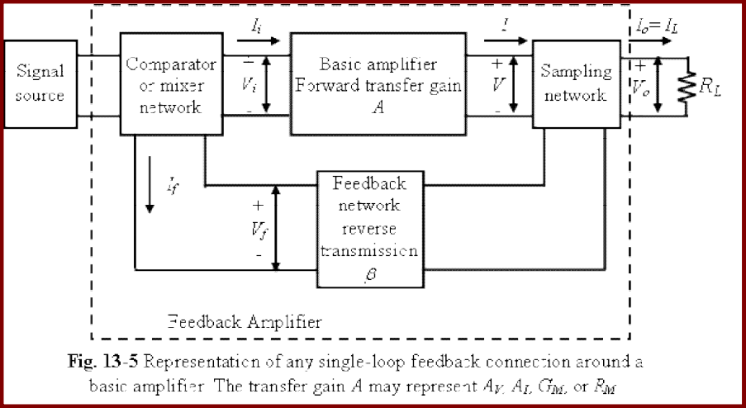
cont….
General feedback amplifier structure
The representation of any single-loop feedback connection around a basic amplifier is shown in below
3
8

Slide 10
cont….
The basic parts of a single-loop feedback connection around a basic amplifier are as follows:
(a) Signal source,
(b) Feedback network with reverse transmission,
(c) Sampling network,
(d) Comparator or mixer network, and
(e) Basic amplifier with forward transfer gain.
Signal Source:
Signal source is either a signal voltage Vs in series with a resistor Rs (a Thevenin’s representation) or a signal current Is in parallel with a resistor Rs (a Norton’s representation).
Feedback Network: The feedback network is usually a passive two-port network which may contain R/C/L.
3
9

Slide 11
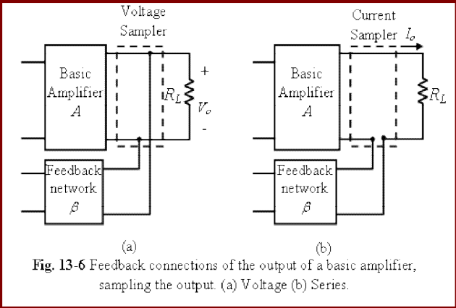
cont….
Sampling Network:
Two types of sampling networks can be used. These two sampling networks are:
Voltage or node sampling: In this
type of sampling system the output is
sampled by connecting the feedback
network in shunt across the output.
Current or loop sampling: In this type of sampling system the output is sampled by connecting the feedback network in series with the output. Fig. 13-6(b) shows the representation of current or loop sampling network.
3
10

Slide 12
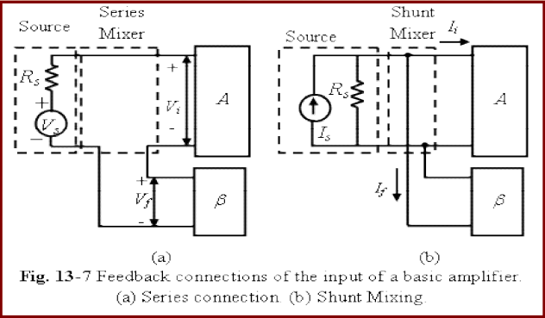
cont….
Comparator or mixer network:
Mixer network circuit is either series (loop) input or shunt (node) input connections.
3
11

Slide 13
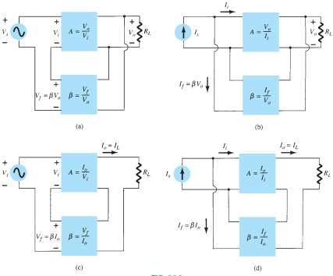
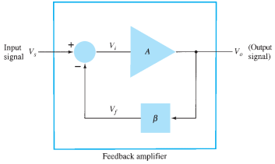
Feedback Topologies
There are two main types of negative feedback circuits. They are −
• Negative Voltage Feedback
• Negative Current Feedback
There are four basic ways of connecting the feedback signal. Both voltage and current can be fed back to the input either in series or parallel.
1. Voltage-series fb
2. Voltage-shunt fb
3. Current-series fb
4. Current-shunt fb
12

Slide 14
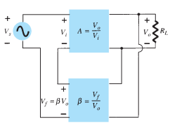
Cont….
1, Voltage-Series Feedback
In the voltage series feedback circuit, a fraction of the output voltage is applied in series with the input voltage through the feedback circuit.
This is also known as shunt-driven series-fed feedback, i.e., a parallel-series circuit.
As the feedback circuit is connected in shunt with the output, the output impedance is decreased and due to the series connection with the input, the input impedance is increased.
13

Slide 15
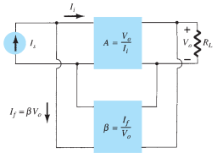
Cont….
2, Voltage-Shunt Feedback
In the voltage shunt feedback circuit, a fraction of the output voltage is applied in parallel with the input voltage through the feedback network.
This is also known as shunt-driven shunt-fed feedback i.e., a parallel-parallel proto type.
As the feedback circuit is connected in shunt with the o/p and the i/p as well, both the output impedance and the input impedance are decreased.
14

Slide 16
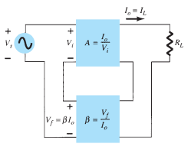
Cont….
3, Current-Series Feedback
In the current series feedback circuit, a fraction of the output voltage is applied in series with the input voltage through the feedback circuit.
This is also known as series-driven series-fed feedback i.e., a series-series circuit.
As the feedback circuit is connected in series with the o/p and the i/p as well, both the output impedance and the input impedance are increased.
15

Slide 17
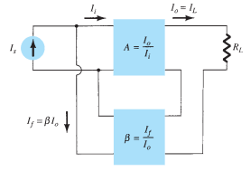
Cont….
4, Current-Shunt Feedback
In the current shunt feedback circuit, a fraction of the output voltage is applied in series with the input voltage through the feedback circuit.
This is also known as series-driven shunt-fed feedback i.e., a series-parallel circuit.
As the feedback circuit is connected in series with the output, the output impedance is increased and due to the parallel connection with the input, the input impedance is decreased.
16

Slide 18
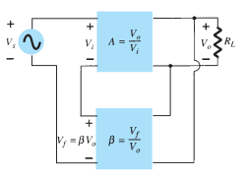
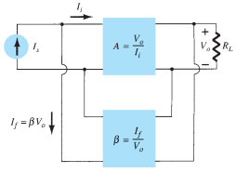


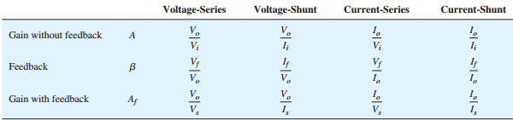
Gain with feedback
Voltage-Series Feedback Voltage-Shunt Feedback
The overall voltage gain with feedback is
17

Slide 19
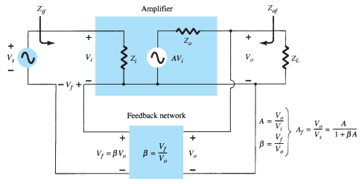
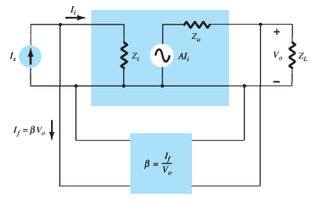


Input Impedance with Feedback
A more detailed voltage-series and voltage- shunt feedback connection is shown below.
…..1 ……2
Eq (1) applies to both voltage-series
and current-series configurations.
The input impedance with series feedback is
seen to be the value of the input impedance
without feedback multiplied by the factor
18

Slide 20
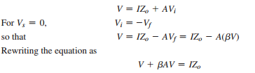

Output Impedance with Feedback
Zo is dependent on voltage or current feedback is used.
For voltage feedback, the output impedance is decreased, whereas current feedback increases the output impedance.
Voltage-Series Feedback
The output impedance is determined by applying a voltage V, resulting in a current I, with Vs shorted out (Vs = 0).
Output impedance with feedback
19

Slide 21
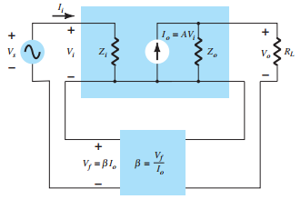


Cont….
Current-Series Feedback
The output impedance with current-series feedback can be determined by applying a signal V to the output with Vs shorted out, resulting in a current I, the ratio of V to I being the output impedance.
Zof output impedance with current-series feedback
20

Slide 22
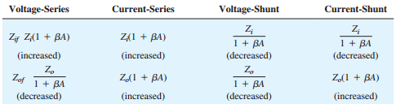
Cont….
Effect of Feedback Connection on Input and Output Impedance
Example 1 Determine the voltage gain, input, and output impedance with feedback for voltage-series feedback having A = -100, Ri = 10k, and Ro = 20k
for feedback of
Example 2 Calculate the gain, input, and output impedances of a voltage-series feedback amplifier having A =-300, Ri =1.5k, Ro=50k, and feedback factor of 1/15.
21

Slide 23
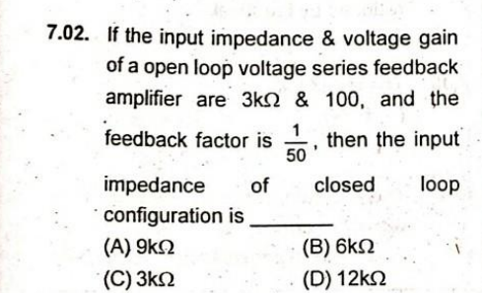
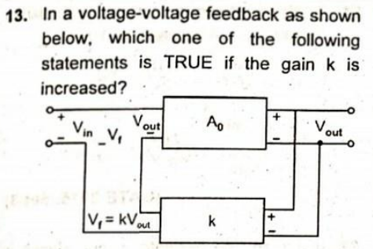
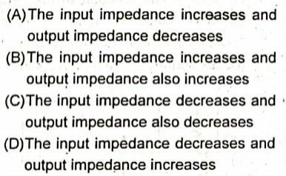
Cont….
22

Slide 24
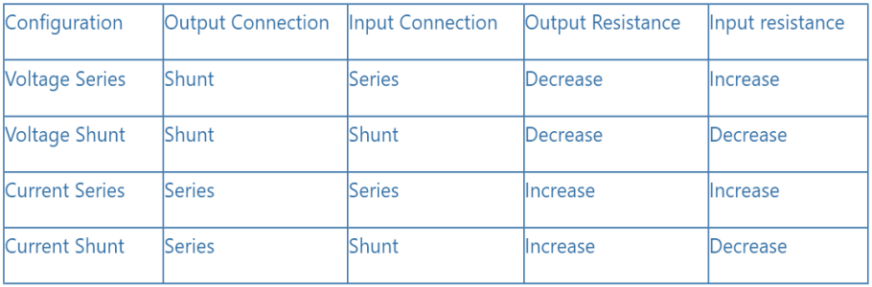
Cont….
Trick to remember
The first term shows how the feedback is taken
Voltage is measured in parallel (by voltmeter) –
Hence 1st term voltage means, the parallel
connection at the output
Current is measured in series - Hence 1st term current means series connection at the output.
Series connection increases resistance.
Parallel connection decreases resistance.
23

Slide 25
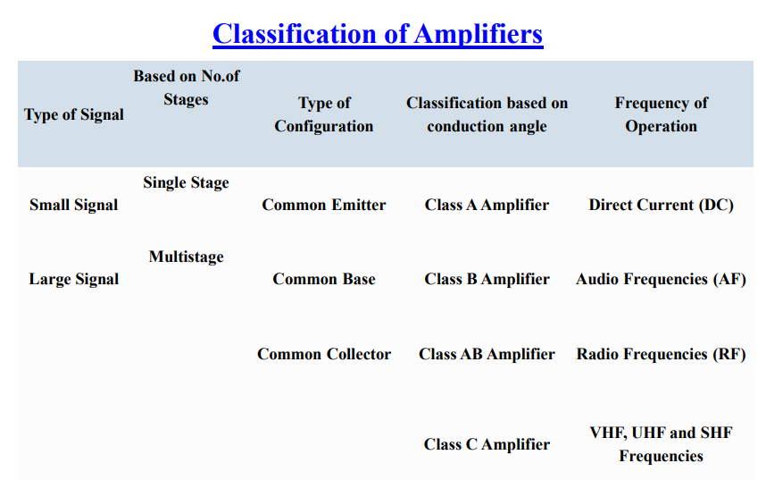
Classification of amplifiers
24

Slide 26
Cont….
Based on the magnitudes of the input and output impedances of an amplifier relative to the source and load impedances, respectively, amplifiers can be classified
into four broad categories as:
(a)Voltage amplifier
(c) Trans-conductance amplifier,
(b)Current amplifier
(d) Trans-resistance amplifier.
Voltage amplifier
A voltage amplifier circuit is a circuit that amplifies the input voltage to a higher voltage.
5
25

Slide 27
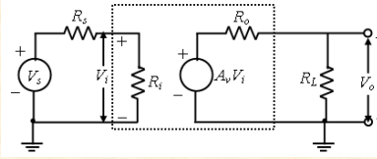
Cont….
Thevenin’s equivalent circuits of a voltage amplifier
Vs= source voltage, Rs= source resistance,
Vo= output voltage, Vi= amplifier input voltage,
Ri= amplifier input resistance, Ro= amplifier output resistance,
RL= external load resistance.
If (Ri>> Rs), then Vi Vs
(Ro<< RL), then Vo AvVi AvVs Hence, the output voltage is proportional to input voltage.
Av represents Av=Vo/Vi with RL= , and hence represents the open-circuit voltage amplification, or voltage gain.
5
26

Slide 28
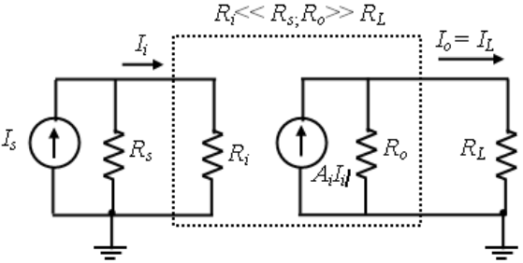
Cont….
Current amplifier: A current amplifier is defined as an amplifier, which provides an output current proportional to the input current.
Here,
Is= source current,
Ii = amplifier input current,
Io= IL= output or load current,
(Ri<<Rs), then Ii Is.
(Ro>> RL), then Io AiIi AiIs Norton’s equ
Ai=Io/Ii with RL=0, and hence represents the current gain
5
27

Slide 29
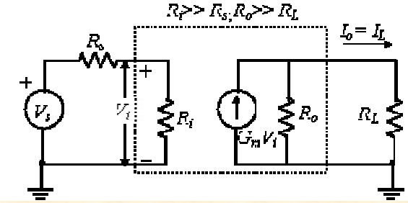
Cont….
Trans-conductance amplifier: A trans-conductance amplifier is defined as an amplifier, which provides an output current proportional to the input voltage.
The proportionality factor is independent of the magnitudes of the Rs and RL.
(Ri>> Rs), then Vi Vs.
(Ro>> RL), then
Io GmVi GmVs.
Thevenin’s equivalent in its I/p circuit and a Norton’s equivalent in its o/p circuit.
Gm=Io/Vi with RL=0, and hence represents the short-circuit transfer conductance (trans-conductance) or gain.
5
28

Slide 30
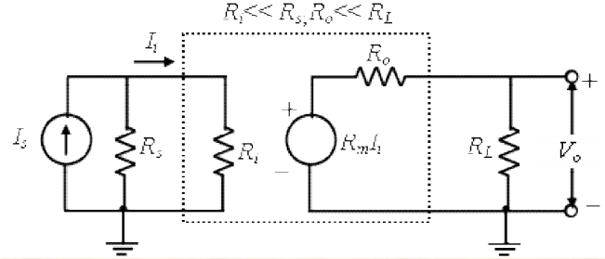
Cont….
Trans-resistance amplifier: A trans-resistance amplifier is defined as an amplifier, which provides an output voltage proportional to the input current.
The proportionality factor is independent of the magnitudes of the (Rs) and (RL).
(Ri <<Rs),then Ii Is.
(Ro<< RL), then
Vo RmIi RmIs.
Rm=Vo/Ii with RL=, and hence represents the
open-circuit transfer resistance (trans-resistance), or gain.
5
29

Slide 31
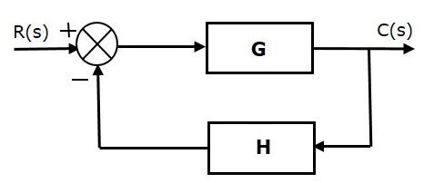

Effect of Feedback on Different Parameters
Transfer gain
Negative feedback control system
Transfer function of negative feedback control system is,
Effect of Feedback on Overall Gain
We can say that the overall gain of negative feedback closed loop control system is the ratio of 'G' and (1+GH). So, the overall gain may increase or decrease depending on the value of (1+GH).
If the value of (1+GH) is less than 1, then the overall gain increases. In this case, 'GH' value is negative because the gain of the feedback path is negative.
If the value of (1+GH) is greater than 1, then the overall gain decreases. In this case, 'GH' value is positive because the gain of the feedback path is positive.
5
30

Slide 32


Cont….
Gain Stability:
An important advantage of negative voltage feedback is that the resultant gain of the amplifier can be made independent of transistor parameters or the supply voltage variations,
For negative voltage feedback in an amplifier to be effective, the designer deliberately makes the product Aβ much greater than unity.
Therefore, in the above relation, ‘1’ can be neglected as compared to Aβ and the expression becomes
It may be seen that the gain now depends only upon feedback fraction, β,
5
31

Slide 33

Cont….
As feedback circuit is usually a voltage divider (a resistive network), therefore, it is unaffected by changes in temperature, variations in transistor parameters and frequency. Hence, the gain of the amplifier is extremely stable.
Noise:
There are numbers of sources of noise in an amplifier. The noise N can be reduced by the factor of (1+Aβ),
so that the noise with feedback is given by
A definite reduction in noise will result from the use of negative feedback.
5
32

Slide 34

Cont….
Distortion:
A power amplifier will have non-linear distortion because of large signal variations.
The negative feedback reduces the nonlinear distortion. It can be proved mathematically that:
It is clear that by applying negative feedback, the distortion is reduced by a factor (1+Aβ)
5
33

Slide 35
THANK YOU
FOR YOUR
ATTENTION
END

